Slide 2
Customizing the Brightcove Player
Matt Boles, Learning Specialist
mboles@brightcove.com or training@brightcove.com

Slide 3
Introducing the Course

Slide 4
Customizing Player Appearance

Slide 5
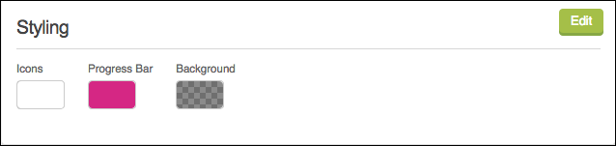
Customization Approaches
Very limited options in Studio UI
Manual customization with CSS

Slide 6
Steps for Customization of Player Appearance
Decide what you would like to change
Determine appropriate CSS selector for the element you wish to change
Create and apply the CSS

Slide 7
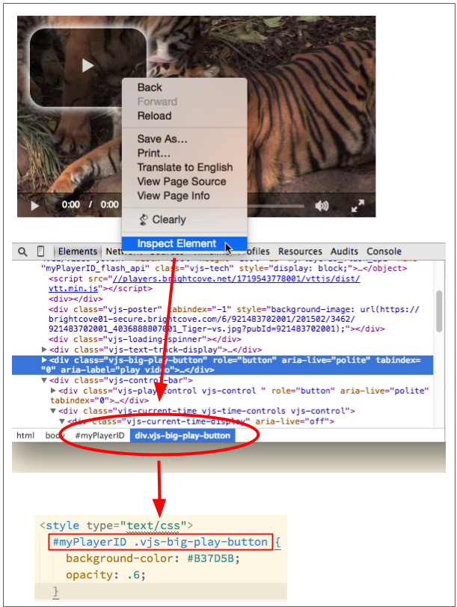
Determine Element Selector – Example 1
In Chrome, right-click on play button
Inspect element
Look at "path" in Development Tools
Translate into style

Slide 8
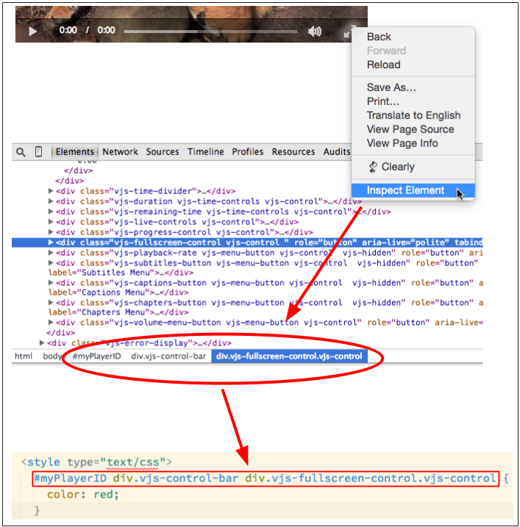
Determine Element Selector – Example 2
In Chrome, right-click on fullscreen button
Inspect element
Look at "path" in Development Tools
Translate into style

Slide 9
Demo 1: Customizing the Big Play Button with CSS

Slide 10
Thank You!
Matt Boles
mboles@brightcove.com

